Slide 1

COMP491 SenIor Desıgn Project I 2D Story-based Ai Supported Game Design
AdvIsor :
Tuna Çakar
Team Members :
Atakan Ermete
Muhammed Rahmetullah Kartal
Zeynep Ayyüce Çay

Slide 2
Project Defınıtıon
Set in an imaginary World, this game is a story-driven 2D RPG. The goal is to add a new viewpoint to the game industry by encouraging Artificial Intelligence (AI) in-game quests and story flow in accordance with the player's decisions during the game. You play the game as an American army soldier against Nazi Germany in Second World War.

Slide 3
What Has Been Done So Far...

Slide 4
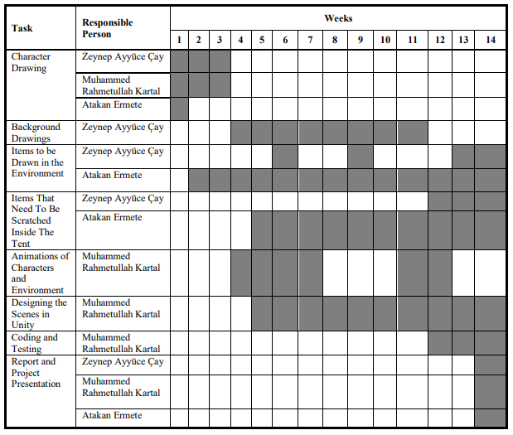

Slide 5
OUR PLANS

Slide 6
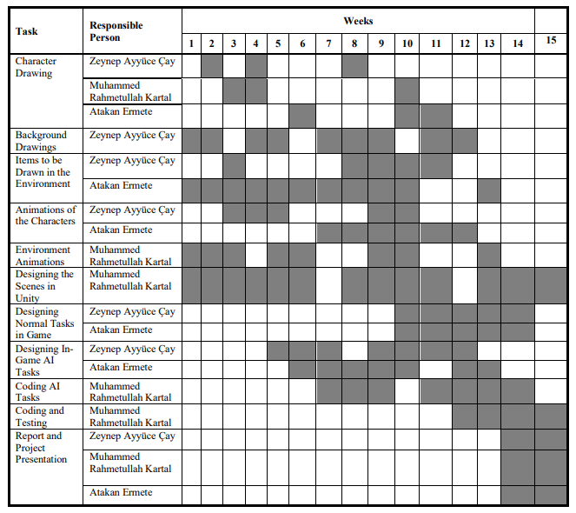

Slide 7
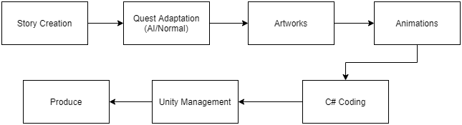
Workflow scheme

Slide 8
IsolatIon Game and Unıty DemonstratIons…

